Slide 1
Initiative for Women in Business
Rotman School of Management University of Toronto
May 9, 2019 Linda Torry

Slide 2
Filling the Female Talent Pipeline: How to support women in the advancement of their careers
May 9, 2019 Linda Torry

Slide 3
About the Initiative
Championing progress in gender diversity since 2008
Rotman is the only business school in Canada with a dedicated Initiative for Women in Business
Building organizations’ female talent pipelines for leadership & succession planning
Leadership and professional development programs

Slide 4
About the Initiative
Building a community of business leaders exposed to themes in women leadership and diversity
Women in Leadership speaker series & networking events
Guiding businesses in diversity strategies – member 30% Club Canada
Sharing expert points-of-view in media interviews in Canada and around the world
10,400+ Twitter followers @RotmanWomen

Slide 5
Programming
From the classroom to the boardroom, we offer specialty and professional development programs for the ambitious:
Leadership Development for Women: Early Career
Leadership Development for Women: Mid to Senior Level
The Judy Project
Senior Level to CEO
Back to Work
Leadership in Administration
Excellence in Administration
Business Leadership for Women Lawyers
May 29, 2019 Prepared by Linda Torry

Slide 6
How to support women in the advancement of their careers
May 9, 2019 Linda Torry

Slide 7
Retention of Female Talent
Provide opportunities to take on more responsibility and accountability.
Equip employees to do so with additional skills training, mentorship and support.

Slide 8
Retention of Female Talent
Promote personal authenticity and self-cultivation as stepping-stones to team leadership and increased accountability.
Provide coaching for personal and professional growth
Address challenges faced when senior level managers transition to higher levels of leadership.

Slide 9
Leadership Development for Women
The Judy Project*
Mid to Senior
Early Career
Canada’s Executive Forum for Women
Excellence & influential women leaders
Becoming an exceptional leader
Leadership & networks
Art of personal branding
Leadership in organizational crisis
Global leadership
Leader as architect
*by CEO nomination
5 Days: May 5 – 10 in King City
Enhances leadership effectiveness and broadens leadership capacity
Developing leadership
Key change leadership & team building
Integrative thinking
Strategic thinking
Strategic networks
360 Assessment
4 Days: Nov 18 – 21 at Rotman
For those who aspire to positions of greater influence
Effective leadership
Personal effectiveness
Career management
EQ assessment
2 Days: Oct 29 – 30 at Rotman

Slide 10
Retention of Female Talent
Provide women at various levels a safe place to support one another in their career advancement as well as speak up about workplace concerns.
Leadership should heed the advice provided through these vehicles. Women are speaking up to say what they need. Ideas ought to be implemented.

Slide 11
Retention of Female Talent
Parental leaves should be called this rather than maternity or paternity leaves so that either parent feels that they can take time away from their career and not be penalized.
When people return from family care leaves (which may include elder care), provide options for flexible work arrangements.
Acknowledge that this may be a stressful time in their lives and provide support through an Employee Assistance Program.
Lead by example. As a leader, saying that you are leaving for a family member’s appointment shows that you take an active role and that family matters.

Slide 12
Professional Development Programs
Leadership in Administration
Excellence in Administration
Women Lawyers
For administrative professionals seeking administrative excellence
Personal productivity
Influencing skills
Communication strategies
EQ assessment
2 Days: Oct 16 - 17 at Rotman
For administrative professionals to achieve and maintain superior administrative performance
Mindfulness and Emotional Intelligence
Negotiating As A Leader
Leadership Presence
Decision-Making
2 Days: June 4 - 5 at Rotman
For practicing lawyers who aspire to partnership
Personal productivity
Influencing skills
Communication strategies
EQ assessment
2 Days: April at Rotman
May 29, 2019 Prepared by Linda Torry

Slide 13
Filling the female talent pipeline
May 9, 2019 Linda Torry

Slide 14
Pool of Workforce Returnees
Boston Consulting Group
Two Groups you Can’t Ignore (but Probably Do) in the War for Talent
By Matt Krentz, Jenn Garcia-Alonso, Frances Brooks Taplett, and Susie Grehl
Workforce Returnees are: people who left the workforce for various reasons and are ready to resume their careers
This talent pool is increasing because of the nature of work.
Opting to step off the career track
Family responsibilities
Non-work reasons, like travel
Not a reflection of lower ambitions
Busy, complicated lives with priorities that change over time
May 29, 2019 Prepared by Linda Torry

Slide 15
Skills Developed During Time Away
Leadership
Crisis management
Negotiating
Time management
Prioritizing
Continuous learning of new skills
May 29, 2019 Prepared by Linda Torry

Slide 16
How Access this Talent Pool
Develop a returner program to invite women to apply
Create a mentorship program and flexible work options
Partner with Rotman Back to Work program and conference
May 29, 2019 Prepared by Linda Torry

Slide 17
Rotman Back to Work Program
Career re-entry support for up to 35 women per year who have been out of the paid workforce for a minimum of 18 months.
Includes select women without Canadian work experience.
Participant Profile:
Avg of 8.5 years work experience and avg break of 8 years
Must have university degree, 40% have advanced degrees
Learning agility and desire to return
May 29, 2019 Prepared by Linda Torry

Slide 18
Corporate Involvement in Back to Work
Opportunity to connect with motivated talent
7 In Class Days over 3 months
Companies define a team project to be delivered within a 2 month time frame by program participants
Several opportunities to connect with program participants
Post program updated resumes provided to participating companies

Slide 19
Back to Work Framework
Prepares women to return to their career’s with:
Increased level of confidence and feelings of empowerment
Better sense of career direction
Increased awareness or present employment context
Deeper understanding of their own strengths and the kind of work that they want to do
Stressful time of transition. Being with other women going through the same thing is an invaluable resource
May 29, 2019 Prepared by Linda Torry

Slide 20
Back to Work Track Record
Program launched in 2010 with founding sponsor, TD Bank
9 Cohorts to date
Over 1000 applicants
35 spots available per offering
Unique partnership with sponsors critical

Slide 21
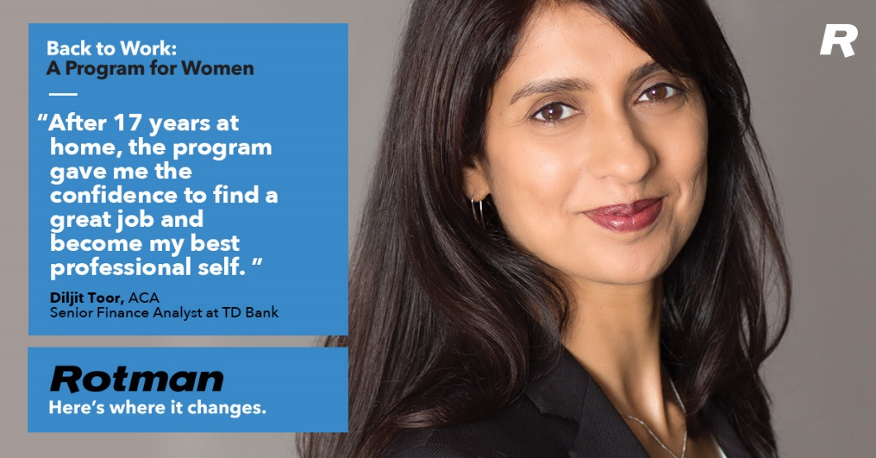
Back to Work
Success Stories
18 year gap, lawyer, Counsel @TD
9 year gap, data scientist, Program Manager @Cancer Care Ontario
10 year gap, PhD scientist in Silicon Valley, Operational Risk @ TD
May 29, 2019 Prepared by Linda Torry

Slide 22
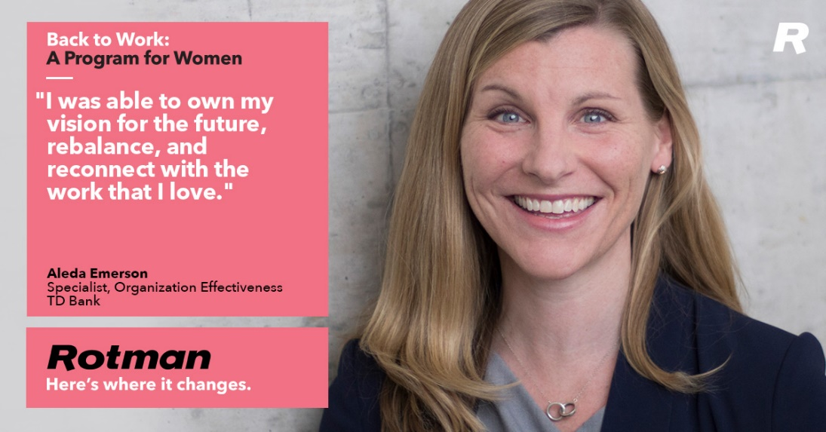
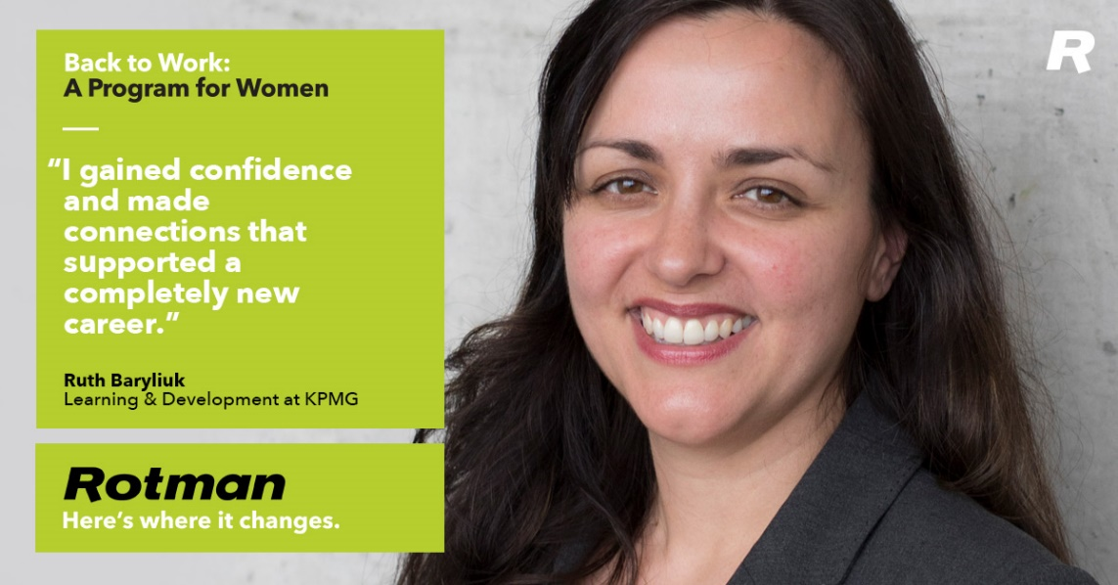
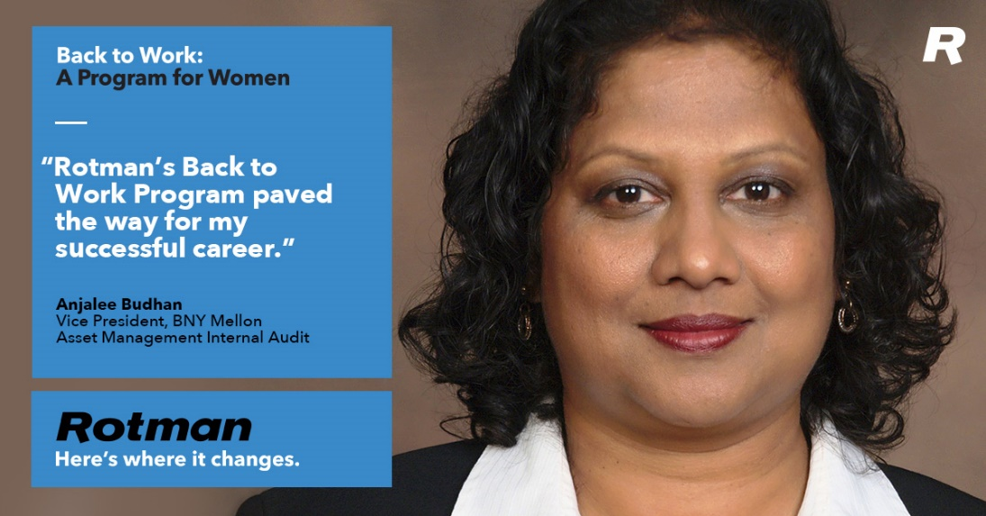
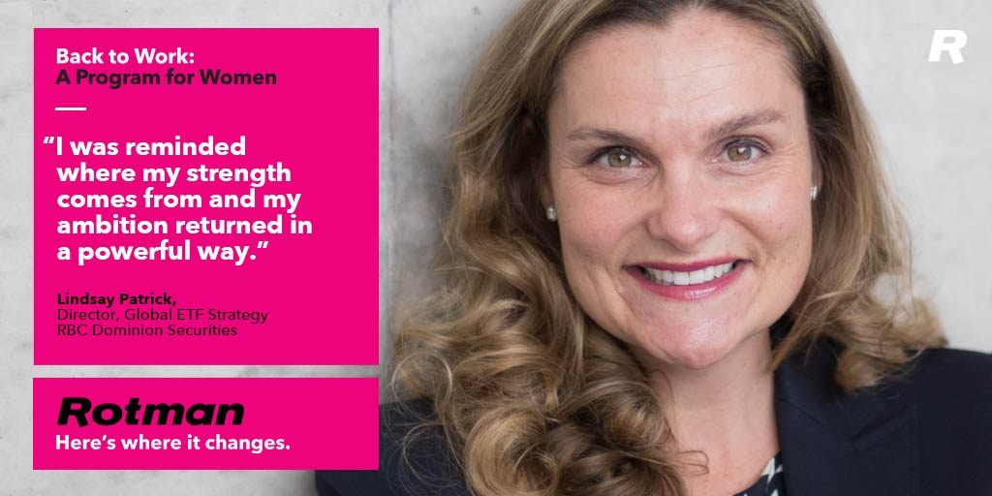

Slide 23
Back to Work Conference
Canada’s first conference for professionals returning to their careers, April 25, 2019 at Rotman
Learn what it takes to return to the workforce after an extended leave
Talks from Experts in their fields on
Networking Effectively
The Importance of LinkedIn
Building your Personal Brand
Negotiating the Job Offer
Women who have successfully relaunched their careers
Connect with potential employers

Slide 24
Thank You

