Slide 1
How to Build and Lead Gender-Balanced Organizations: Practical Tools for CEOs and Board Chairs
Canadian Gender and Good Governance Alliance May 2019
Prof. Beatrix Dart, University of Toronto; Ekta Mendhi, CIBC; Matt Fullbrook, University of Toronto

Slide 2
Current Status in Canada
Sources: 2018 Diversity Disclosure Practices, Osler

Slide 3
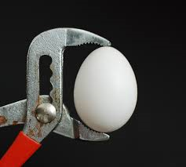
OSC – Comply or Explain
Bloomberg “Financial Services Gender-Equality Index”
Quota in other countries
Campaigns such as The 30% Club Canada
30% Club Canada Investor Statement of Intent
Joint efforts such as The Canadian Gender and Good Governance Alliance
The pressure for gender diversity on boards and in senior roles is increasing
Notes:
s

Slide 4
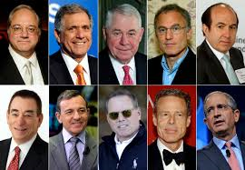
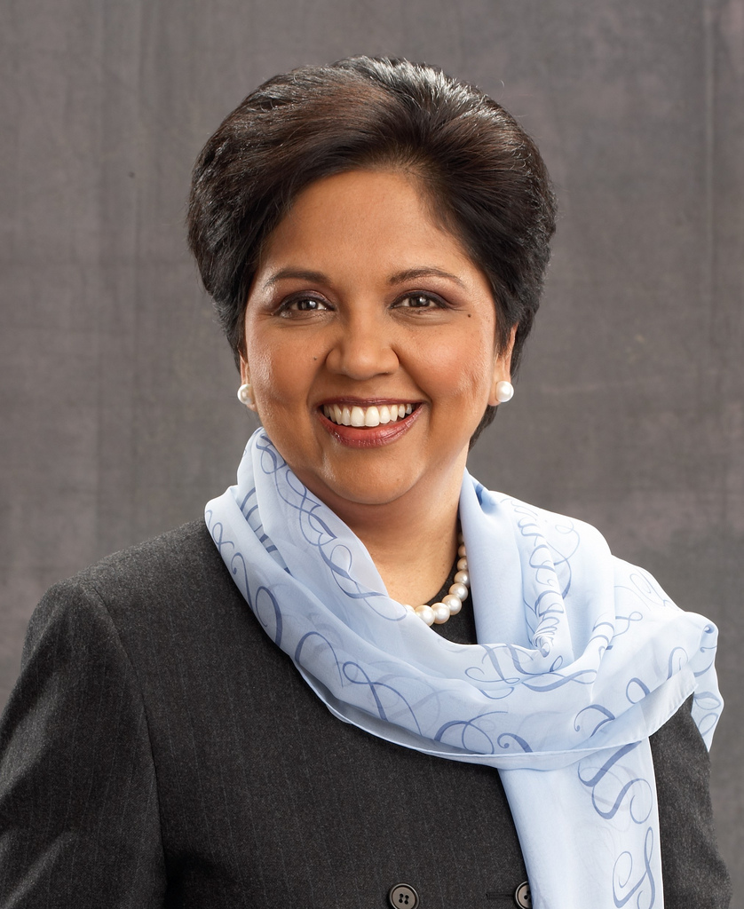
Who are the decision-makers – and how can they be influenced?

Slide 5
30%
representation in senior roles and on boards by 2022 is an aspirational goal, not a quota

Slide 6
Core Principles for 30% Club
We are not an organization or a club, we are a collaborative umbrella campaign
We are not aligned with any one government or institution and are non-partisan
We are non-commercial and don’t charge for membership
We do not support “name and shame” approaches
We are not a diversity initiative, but a voluntary-led business initiative

Slide 7
30% Club Members in Canada
220+
Member Organizations
Focus on corporate firms, but also crown corporations, professional services firms, and large private companies

Slide 8
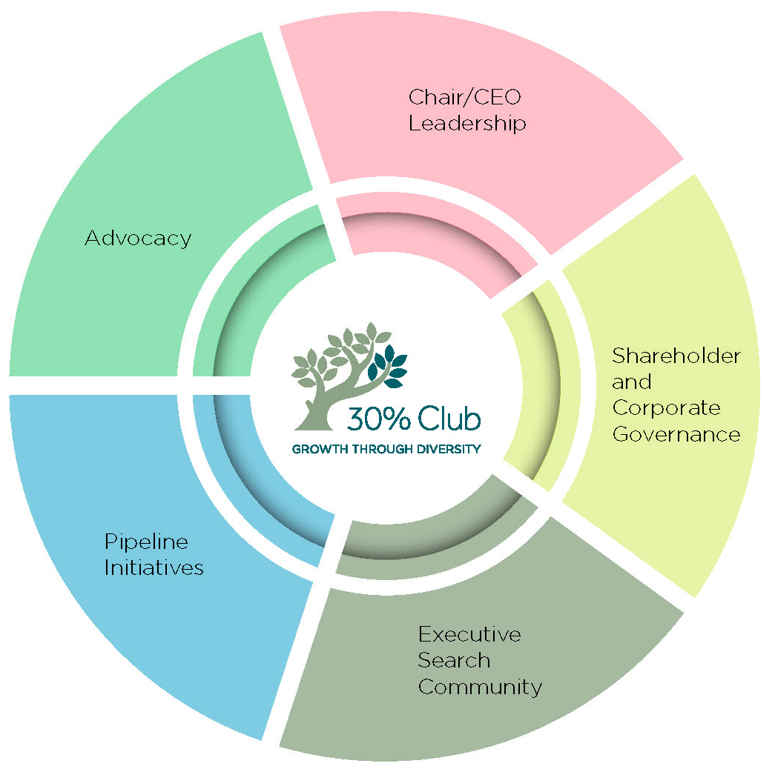
Major Influencers Critical For Success

Slide 9
$4+ trillion in assets
200+ CEOs
13,500+ board directors
430+ institutions
Various levels of government & regulators
5+ million employees
Clarkson Centre for Business
Ethics and Board Effectiveness

Slide 10
Made in Canada
Global Precedent
Notes:
Global precedent

Slide 11
Mobilizing Gender Diversity
to create the
Competitive Edge
- A World Bank Discussion

Slide 12
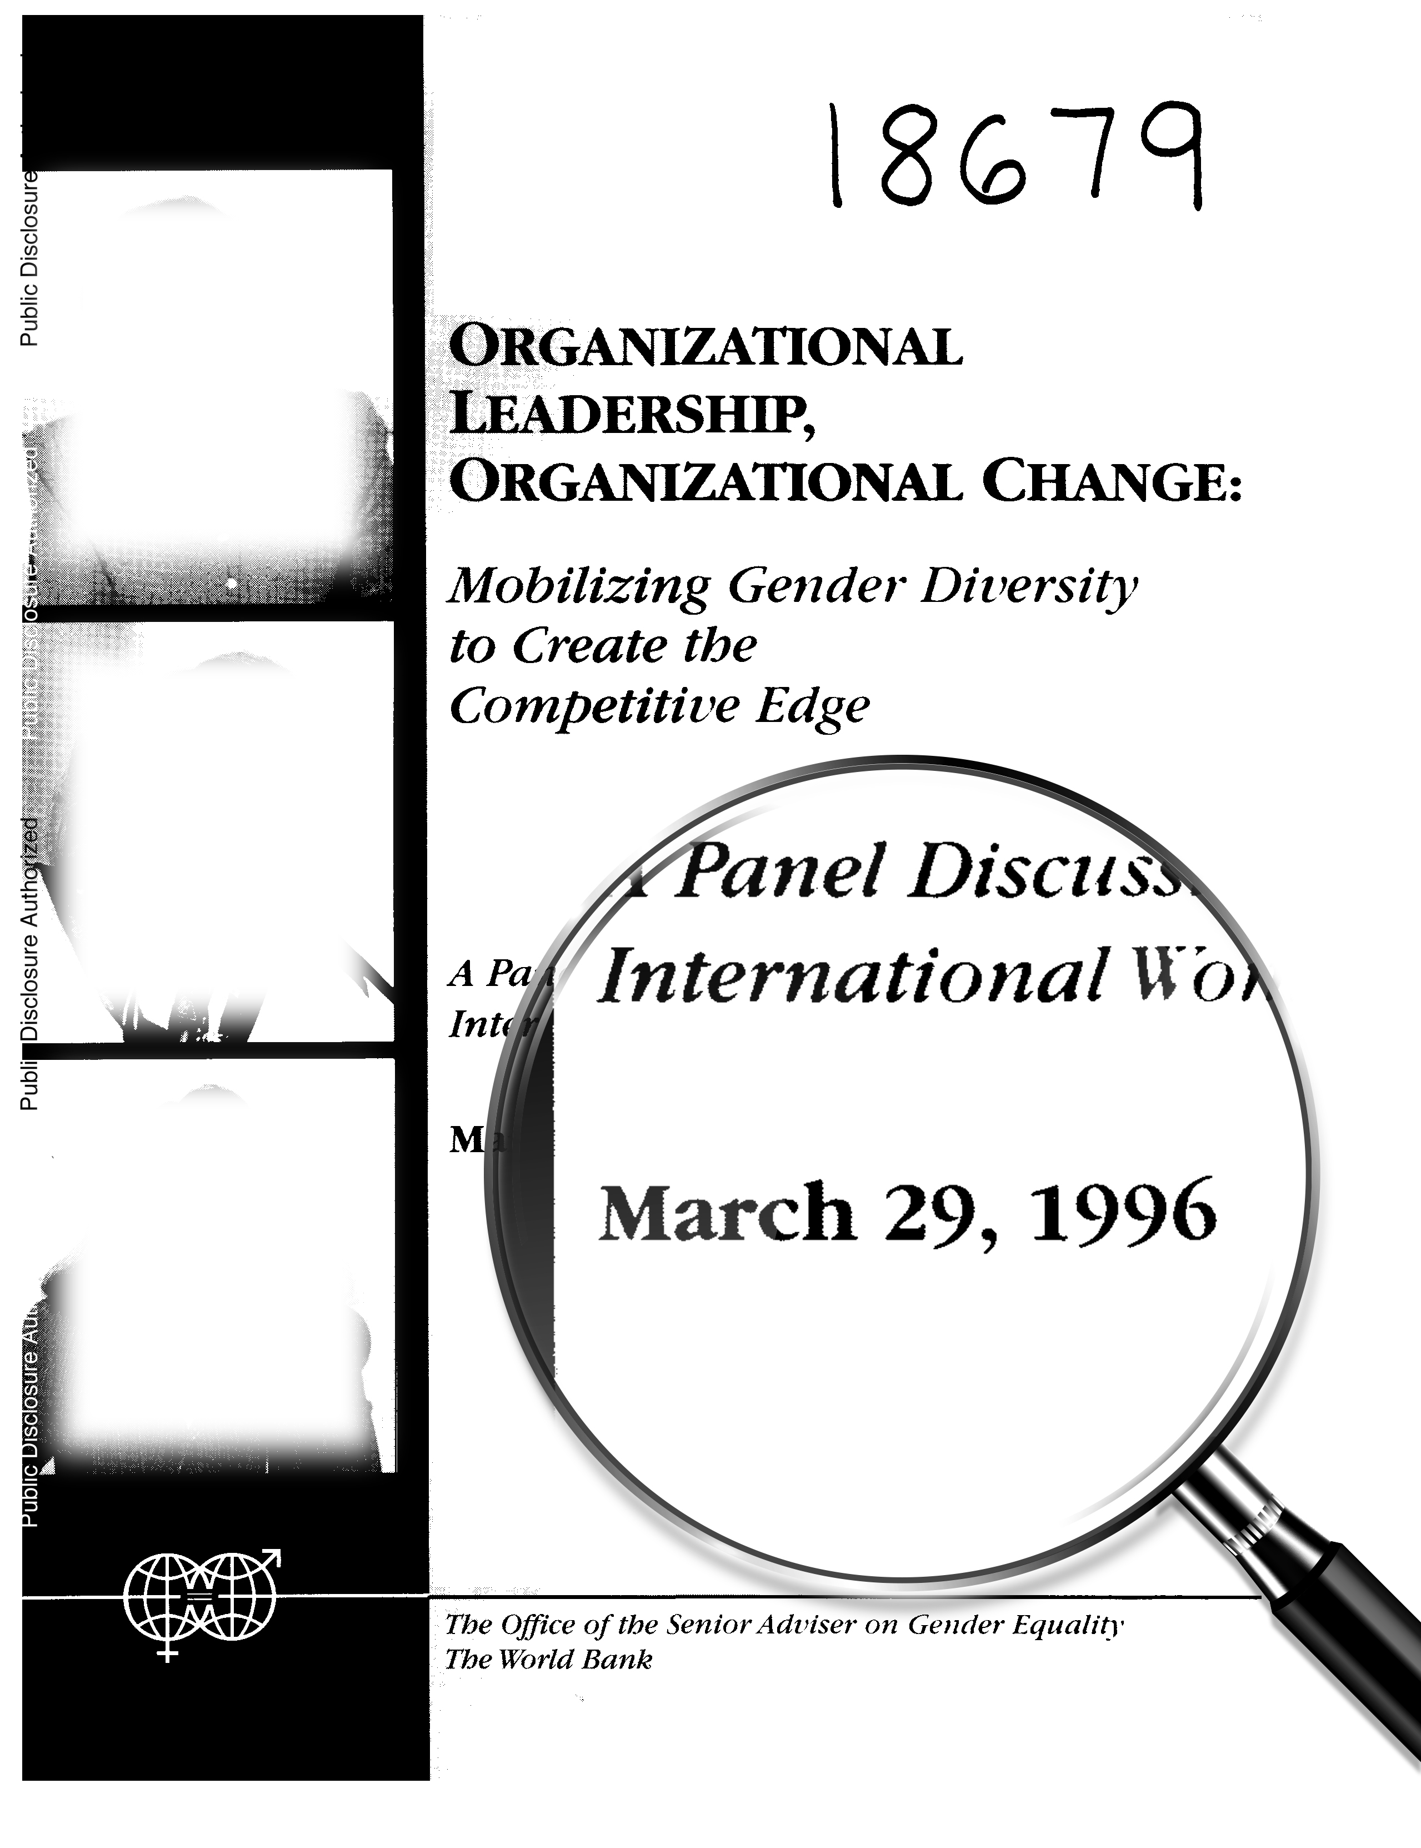

Slide 13
A Curious Consistency

Slide 14
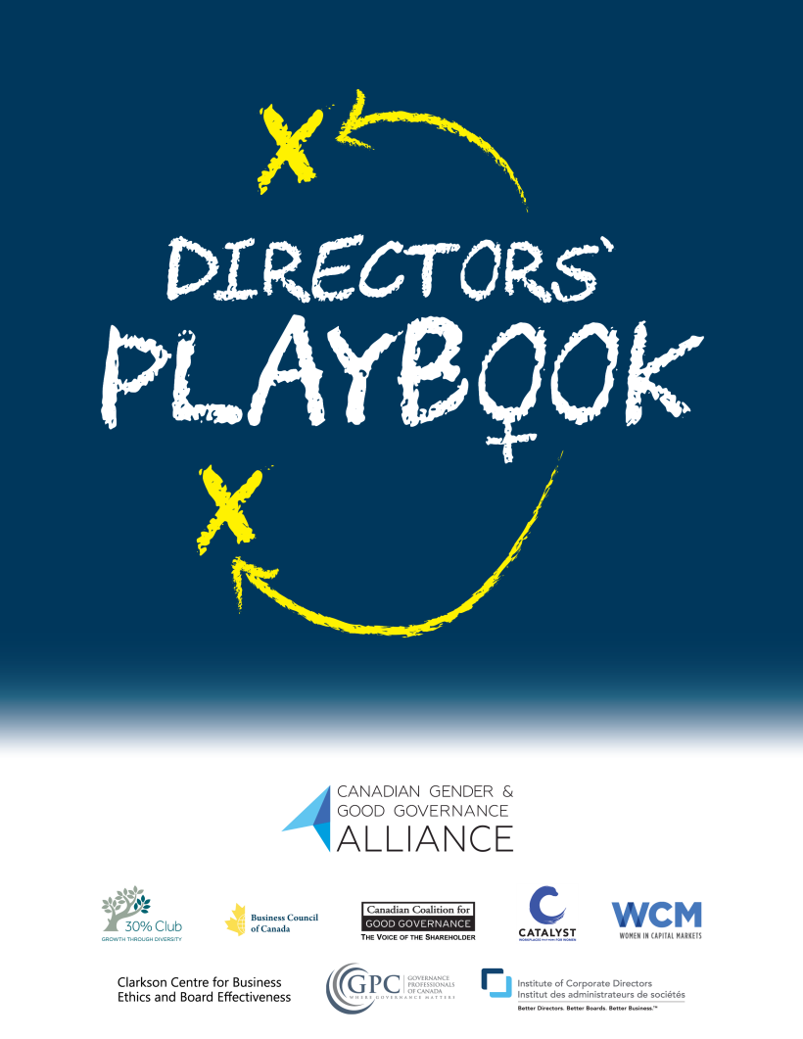

Slide 15
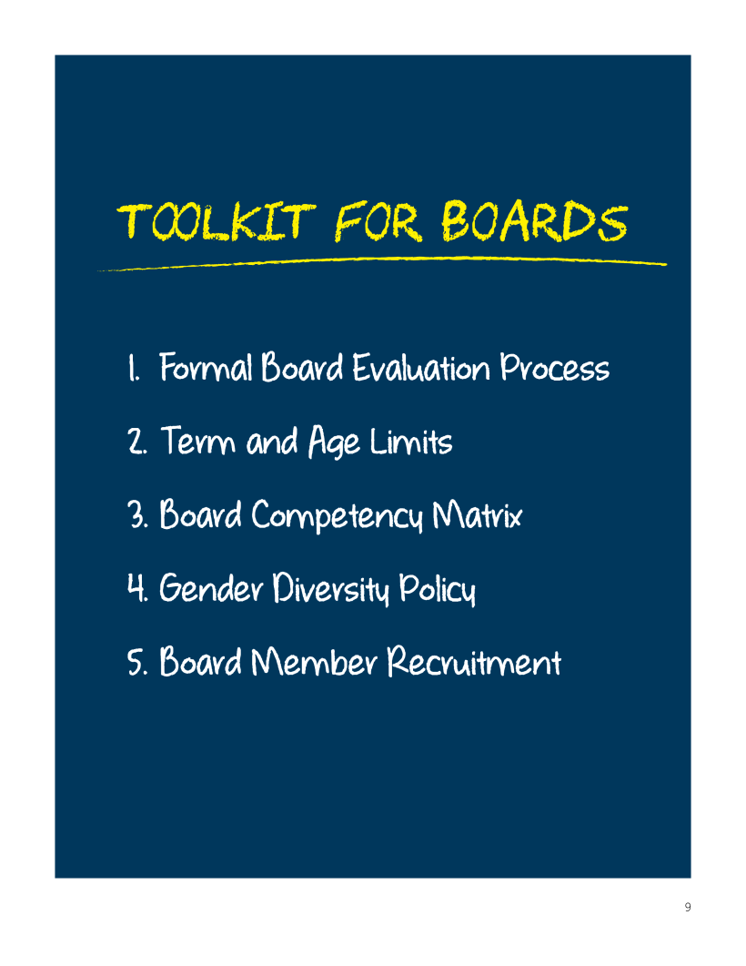

Slide 16
Board renewal research in Canada (OSC data)
Term limits are not consistently implemented
 | Adoption rate | 2011 avg % female board | 2015 avg % female board
Term limit age | 29% | 12% | 20%
Term limit tenure | 8% | 13% | 21%
Term limit age and tenure | 13% | 10% | 22%
None disclosed | 50% | 10% | 15%
Lack of regular board effectiveness discussions
Similarity bias (traditional networks, C-suite only, ….) when renewal is taking place
OSC data 2015, N=131

Slide 17
When having too many experts on the board backfires*
Investigated relationship between domain experts and a bank’s financial performance or survival chances:
In situations of significant uncertainty, the higher the number of banking experts on the board, the greater the likelihood that a bank would go out of business
Why?
“Cognitive entrenchment” – less flexible in thinking and changing perspective
Overconfidence – risk-taking, not asking for enough information
Task conflict – “we have always done it this way” suppressing different view points, ideas and opinion
The risk of similarity bias
*Academic study, 2016, banking industry, 1300 community banks, over 17 years

Slide 18
Final thoughts and action steps
Let’s work together on gender advancement - make sure your company is part of the 30% Club
Engaging men and women in joint problem solving – create joint task forces with shared goals that provide better understanding of the overall picture
Affinity groups segregate rather than integrate! Don’t create in-groups/out-groups
Mandatory diversity programs are doomed to fail, but voluntary ones can have positive impact
Bias training can provide a common language, but won’t change individual behaviour. You can debias processes, and you can use teams to call out biases in real time

Slide 19
Q&A
Thank you!
Ekta Mendhi
CIBC
Ekta.mendhi@cibc.com
Prof. Beatrix Dart
Rotman School of Management
University of Toronto
bdart@rotman.utoronto.ca
Matt Fullbrook
Rotman School of Management
University of Toronto
Matt.fullbrook@rotman.utoronto.ca

